Slide 1
Mid-Year Budget Forum
January 31, 2024

Slide 2
Today’s Topics
Enrollment update
Fiscal Year 2022-2023 actual revenues and expenditures
Fiscal Year 2023-2024 mid-year budget review
A look ahead at the next biennium’s budget strategy and planning
Notes:
Sabah

Slide 3
Enrollment Update
Brad Johnson, Provost and Executive Vice President

Slide 4
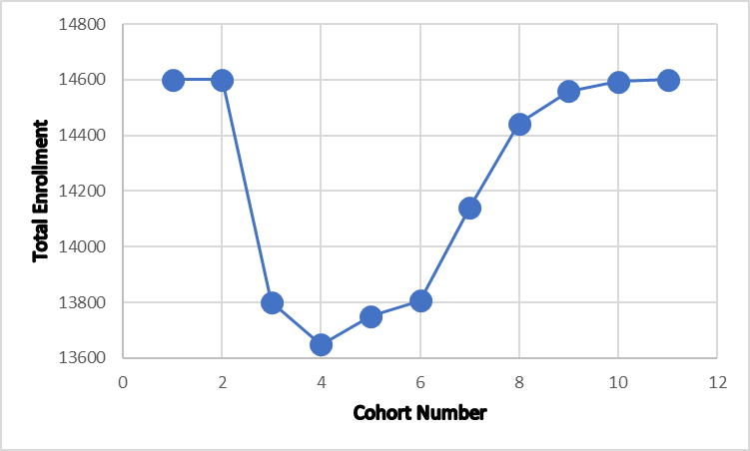
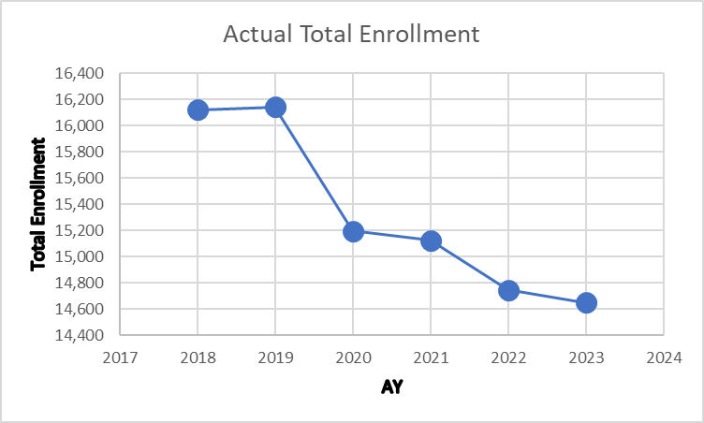
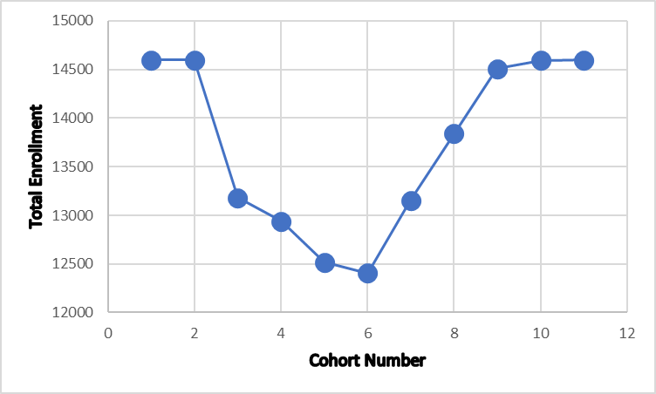
What About Enrollments
2023
1,491 Students

Slide 5
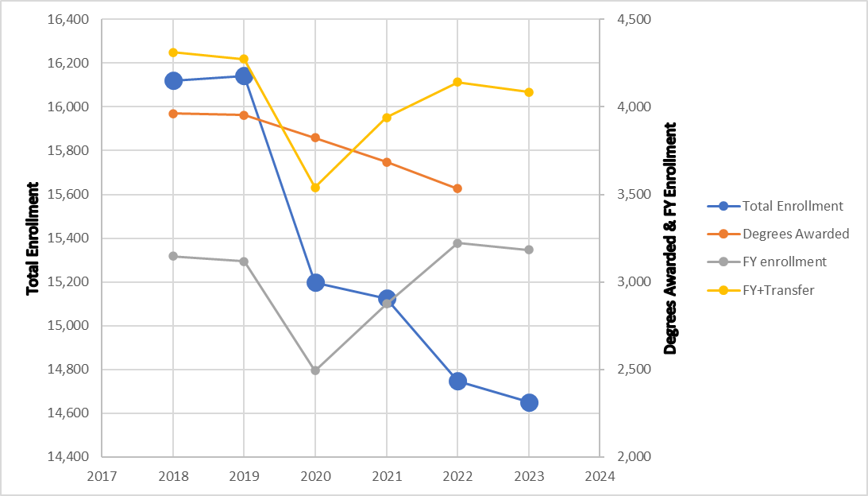
What About Enrollments

Slide 6
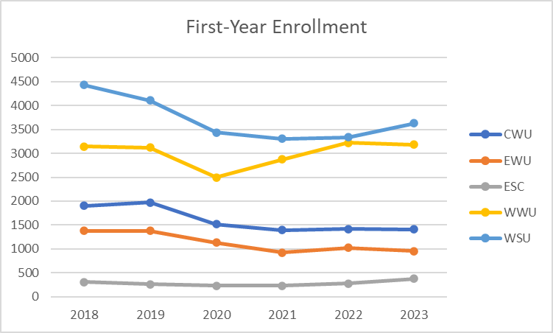
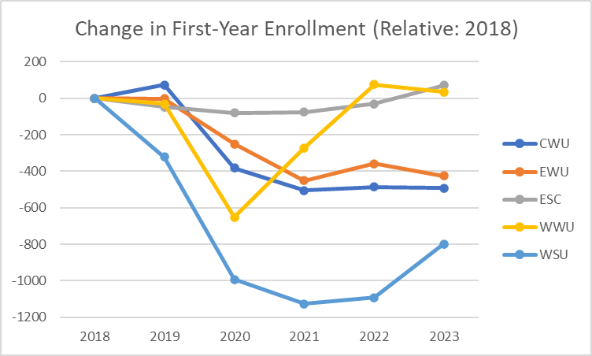
Washington Institutions First Year
Institution | % change
CWU | -25.91
EWU | -30.82
ESC | 22.98
Institution | % change
WWU | 1.11
WSU | -18.03

Slide 7
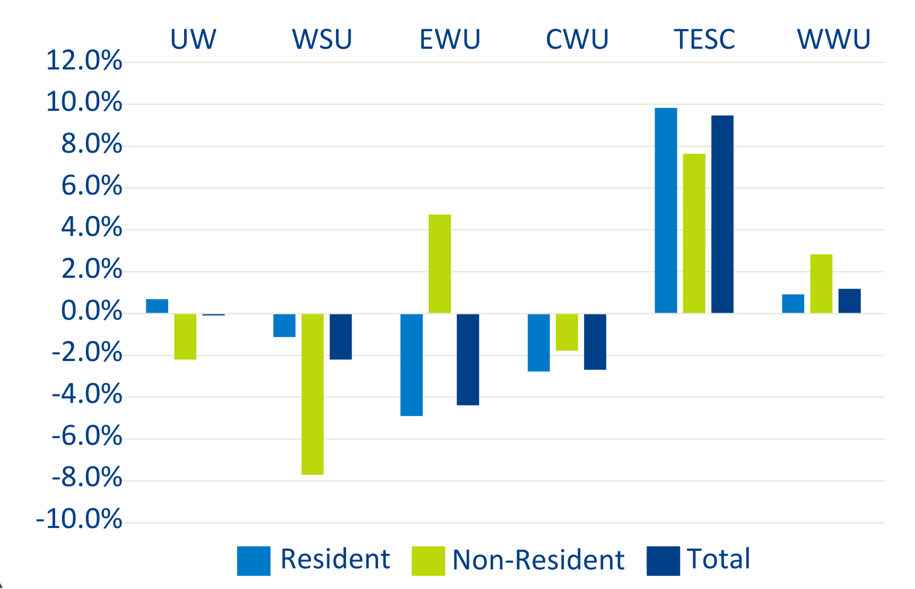
Enrollment Change from Fall 2022 to Fall 2023 State-Funded, Undergraduate, Full-Time-Equivalent Students
Source: TECM 2024 Model State-Funded Undergraduate Enrollment.
2023-24 data is preliminary and estimated for the year.
Notes:
Data presented January 9th to the House Higher Ed Committee:

Slide 8
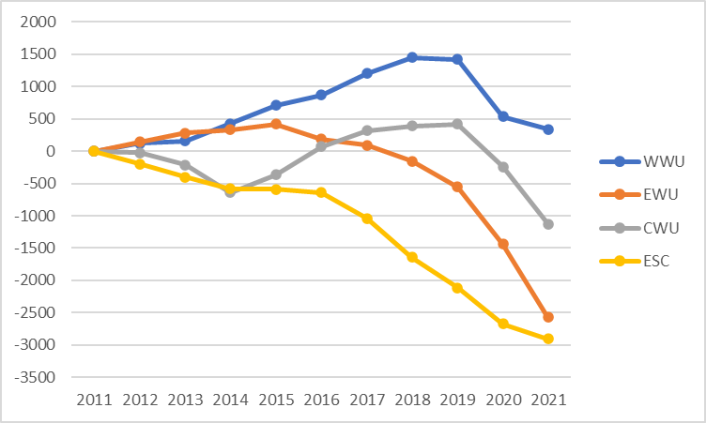
Long-term Total Enrollment Trends
Undergraduate headcounts, relative to Fall 2011
Source: ERDC.wa.gov
WESTERN WASHINGTON UNIVERSITY | MAKE WAVES.

Slide 9
Western had our two largest incoming first-year classes in Fall 2022 and Fall 2023
However, total enrollment is still well below pre-pandemic numbers
The university is trending better than many other institutions across the state and country
Enrollment
Update

Slide 10
Budget Update
Joyce Lopes, Vice President for Business & Financial Affairs

Slide 11
Budget Update
FY 2023-2024 Actuals
We are at the mid-point of our fiscal year, and it is projected university reserves will cover approximately 7.2% of the operating budget.
Fiscal Year 2023-2024 Budgeting
3% across-the-board reduction was achieved by holding/folding vacancies and reducing goods and services.
Fiscal Year 2022-2023 Close Out
Ended with university expenditures exceeding revenue. The remainder of one- time federal stimulus funds and university reserves were used to cover the difference.
Thank you to everyone for their continued support to reach these targets.
The Board of Trustees adopted a policy for reserves to cover at least 10% of the operating budget by Fiscal Year 2031-2032.

Slide 12
The Full Pie: WWU Revenues by Source Fiscal Year 2022-2023 Actuals
Includes $104.4M in operating and $2.0M in capital used for maintenance
Notes:
These are our financial statement numbers.
The top two items, Tuition and Fees and State Appropriations Operating, flow into our state operating budget.

Slide 13
WWU Operating Budget – Flow of Funds
Total Revenues (Operating)
Total Expenses
(State Operating)
Made up of
Made up of
Invest. Income & Differential Tuition
$0.8M
Goods + Services $27.2M
Compliance: Accruals & Deferrals
$10.6M
Tuition + fees $117.7M
State Appropriation
$104.4M
ASA
$4.9M
Salaries + Benefits $189.1M
Fees & FA
Tuition Building Fee
Net Oper.
Tuition $93.0M
Local Operating Expenses $216.3M
Net Pension + OPEB Contra-Expense $10.5M
Local Operating $202.7M
Appropriate Earmarks
$24.7M
WESTERN WASHINGTON UNIVERSITY | MAKE WAVES.
Notes:
Of the $117.7M in tuition and fees, $24.7M is fee revenue collected for specific purposes and not available to the general state operating budget. That leaves $93M in net tuition operating revenue.
Together with our state operating appropriation, the ASA, and a small amount of investment income and differential tuition, that gives us state operating revenues of $202.7M.
The expenses against that $202.7M totaled $216.3 million, mostly in salaries and benefits.
The next slide shows how that difference flows through to our bottom line.

Slide 14
WWU Operating Budget
Beginning Fund Balance $36.1M
Local Operating Revenue $202.7M
The Math, In Millions
$36.1 | Beginning Fund Balance
+$202.7 | Revenue
-$189.1 | Salaries and Benefits
-$27.2 | Goods and Services
+$1.5 | Transfers*
$24 | Ending Fund Balance
($12.1) | Net Change in Fund Balance
*Transfers to Operating Fund from other university funds are net positive in Fiscal Year 22-23
Divisional Budget
Programmatic colleges, departments, etc.
Salaries and Benefits
$189.1M
Goods and services
$27.2M
Misc. transfers,
$1.5M In/Out
(Sums = zero across Univ.)
Ending Fund Balance $24M
Notes:
Of $12.1m, $11.5m was supported by the remaining institutional stimulus dollars from the HEERF grant, previously moved into reserves. The originally adopted FY23 budget plan assumed $8.8m from this source. Thus, an additional $2.7m was utilized in FY23 beyond the budget plan, which fully expended remaining HEERF funds. The remaining $0.6m of variance further reduced the institutional reserve.

Slide 15
WWU Operating Budget Fiscal Year 2022-2023
FT 14 and FT 11 = Operating Budget + Liabilities | Beginning Bal 7/1/22 | Revenues | Expenses | Transfers | Net Change | End Bal 6/30/23
Western Operating Budget (Funds 14 & 11) | $36,115,736 | $202,686,608 | ($216,296,970) | $1,482,815 | ($12,127,546) | $23,988,190
Local Operating Fund (149) | $3,685,926 | $5,741,669 | ($216,025,204) | $211,057,219 | $773,684 | $4,459,610
Institutional Reserve & Other Funds | $32,429,810 | $196,944,939 | ($271,766) | ($209,574,403) | ($12,901,230) | $19,528,580
Departmental Operating Funds in each Division
Institutional Reserve (9.0%)
WESTERN WASHINGTON UNIVERSITY | MAKE WAVES.

Slide 16
Fiscal Year 2024-2025
The governor advanced two of WWU's requests to the legislature for consideration:
Funding for Electrical and Computer Engineering Expansion (Operating Budget)
Minor Works (Capital Budget)
Legislative Session is in progress
We don’t anticipate a need for another across-the-board reduction, but we need to continue to be prudent.
Notes:
Joyce
Minor Works ($500,000 proposed)
- upgrade the elevator in the Humanities Building and construct a pole barn at the Physical Plant to store the large vacuum truck and other equipment sensitive to freezing during the winter

Slide 17
Process Updates
Pause the call for new budget requests as we implement the 3% reduction this year​
Continue to improve our strategic budgeting process to include operating and capital needs​
Develop financial health tools for dashboard​

Slide 18
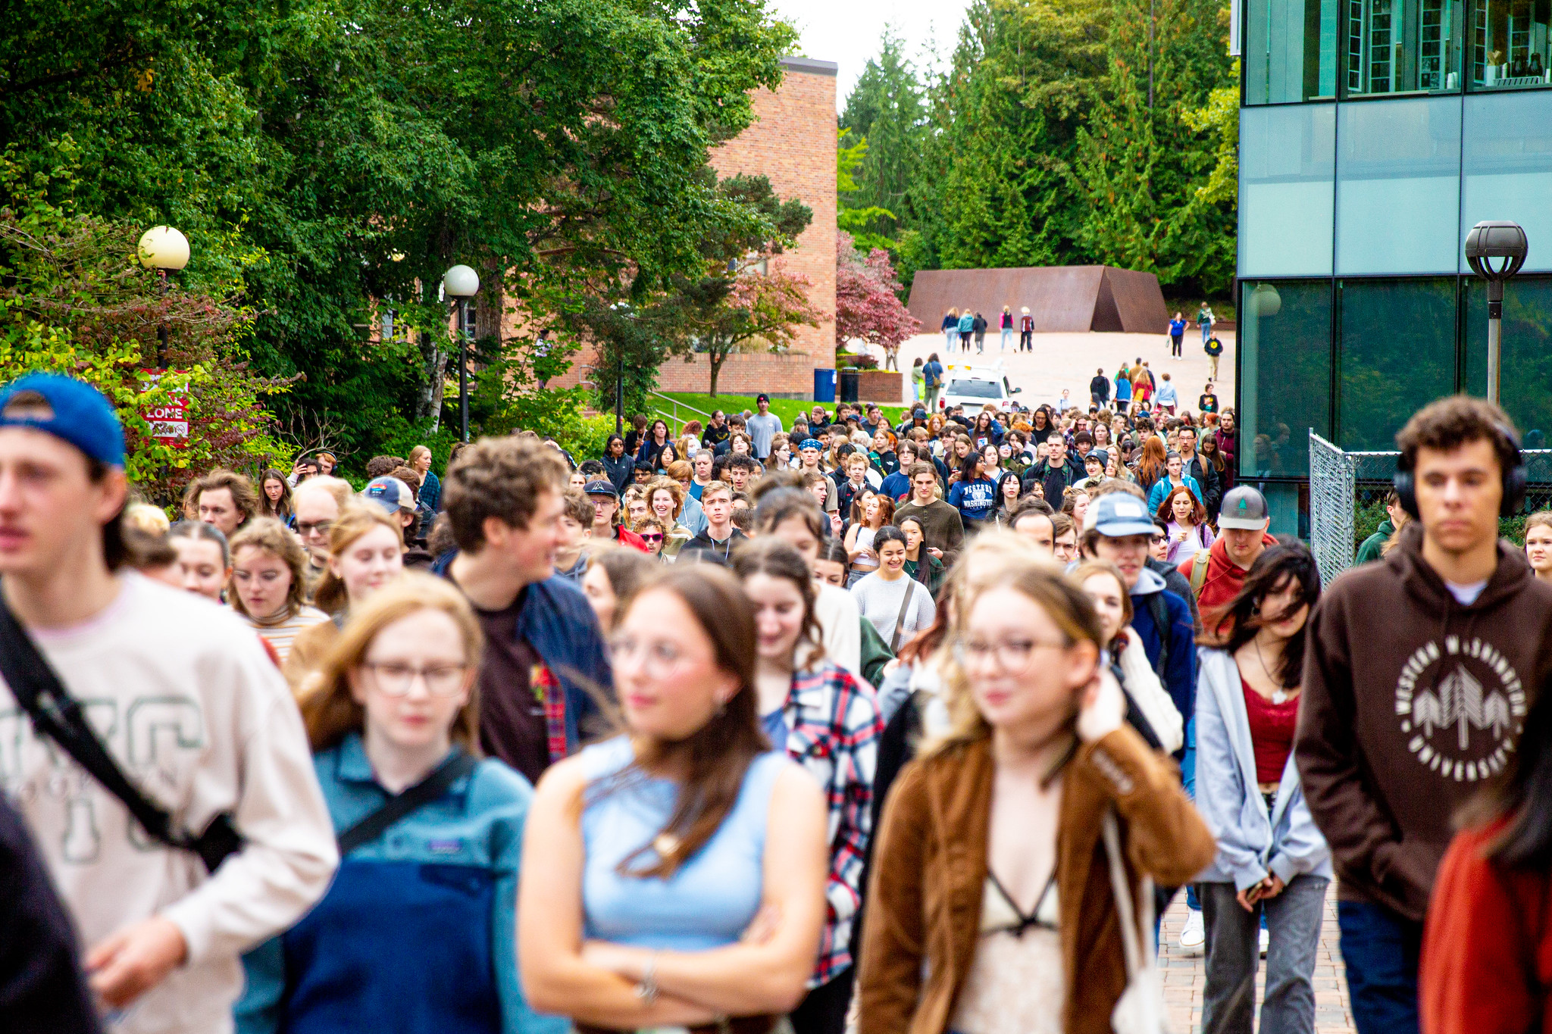
Looking Ahead
We will maintain a laser focus on increasing enrollment both through recruitment of new students and retention of current students.
2025-2027 State Budget Request will focus on more robust state funding for our core operating budget so we can be on a more sustainable budget pathway in the long term.

Slide 19
Questions
WESTERN WASHINGTON UNIVERSITY | MAKE WAVES.

Slide 20
Thank You

